Slide 1

WEEK 5 BGEC 103: BUSINESS COMMUNICATION WEEK 6A BUSINESS LETTERS

Slide 2

OUTLINE
Definitions of business letters
Common types of business letters
Categories of Types of letters (Informal, Semiformal and Formal)
Approaches to Writing Business letters (direct and indirect)
General purposes of writing Business Letters
Features of Business Letters

Slide 3
LEARNING OUTCOMES
By the end of this lecture, the student should be able to:
Differentiate the types of letters and business reports
Construct standard business letters, business reports and memos.
Identify the purposes of business letters and reports.
Use the various approaches to write business letters, reports and memos.

Slide 4
INTRODUCTION
A letter is a written or printed communication addressed to a person or organization by another person or organization and usually sent through the post, and nowadays through technological media.
In most organizations, business letters are mostly the principal means of establishing working relations with the outside world.
It is therefore important that letters sent out are attractively displayed, grammatically correct and conform to acceptable punctuation and spelling.

Slide 5
COMMON TYPES OF BUSINESS LETTERS
Some of the main types are:
Application for a job
Sales - to sell goods or services
Acknowledgment - receipt of a letter or orders
Complaint - to criticise poor service or goods
Confirmation - information or arrangements
Circular – to reach/inform a group (client/staff)

Slide 6
GENERAL PURPOSES OF BUSINESS LETTERS (1)
To inform : giving data and information required in order to initiate or facilitate some action or decision.
To persuade : giving information in such a way as to confirm or alter the attitude of the recipient, securing acceptance or compliance, according to the communicator’s purpose.

Slide 7
GENERAL PURPOSES OF BUSINESS LETTERS (2)
To request : giving information about needs and requirements, so as to elicit information or action.
To confirm: giving information that clarifies and explains previous communication, ensuring that both parties have the same understanding.
To build relationship : giving information in a way as to acknowledge and maintain the relationship between the sender and receiver - mutual trust, loyalty, and respect.

Slide 8
Approaches to writing Business Letters
In business writing, we categorise messages by the writer’s purpose and the initial response we expect from the reader.
Messages can therefore be informative, positive, negative or persuasive.
The approaches we use in writing depend on the nature of the message.
There are two approaches: Direct and indirect

Slide 9
The direct and indirect approaches to writing business letters
With the direct approach, you get the objective right at the beginning of the message.
There is no need for opening explanation or introductory remarks.
This approach is usually used for good news, informative or positive messages.
Informative and positive messages include:
Acceptance
Positive answers to the reader’s request
Information about procedures, services or options
Announcements of policy changes that are neutral or positive
Changes that are to the reader’s advantage

Slide 10
Steps for the Direct approach (1)
Begin directly with the objective.
There is no need for opening explanation or introductory remarks.
Give details and clarifications that will provide an appropriate background. Include necessary explanations where they fit.
If a number of questions are involved, structure them.
Provide any negative elements as positively as possible.
If there are any benefits about the message to your reader, provide them.

Slide 11
Steps for the Direct approach (2)
End with goodwill words adapted to the individual case. Eg. “I will be grateful if you will send the details to me before the close of business on Friday” etc ...
Types:
Routine Enquiries that request for information.
Business letters that ask for information are referred to as routine enquires.
The direct order is more appropriate since there is no need to delay the objective of the message.

Slide 12
Steps for the Direct approach (3)
With an objective to obtain information, you can start the enquiries with a question. Eg.
“Will you please send me details of the products offered by Unique Trust Financial Services?”
Precise questions can come in the body of the letter.
It is advisable to avoid questions that can be ‘yes’ or ‘no’ except when you need any of these answers.

Slide 13
Steps for the Direct approach (4)
Adjustment Grants
Where due to some error on your part, you are unable to satisfy your customer, either you send a new set of products or you give money back.
If you are correcting an error, begin directly with the good news.
Identify the correspondence that you are answering. Eg. “As requested in your March 21st letter.”
Avoid negatives that recall the problems such as “We are sorry we failed to satisfy you…”

Slide 14
The Indirect Approach (1)
This approach is used for bad-news message, also known as indirect message or negative message.
A letter, memo, or e-mail that conveys negative or unpleasant information is likely to disappoint, upset, or even anger a reader.
The indirect approach is preferred for such messages.

Slide 15
The Indirect Approach (2)
Negative messages are received more positively when an explanation precedes them.
An explanation reduces (cushions) the shock of bad news, otherwise the message might appear harsh, thus destroying goodwill.
We should remember that even if it is not possible to make the reader happy with the news we must convey, we still want the reader to feel important.

Slide 16
The Indirect Approach (3)
Negative messages include:
Rejections and refusals (in response to job applications, promotion requests, and the like)
Announcement of policy changes that do not benefit the readers
Negative performance appraisal and disciplinary notices
Product recalls and notices of defect
Adjustment Refusal

Slide 17
The Indirect Approach (4)
The Introductory Paragraph The introductory paragraph in the bad-news message should accomplish the following objectives:
(1) provide a buffer to cushion the bad news that will follow
(2) let the receiver know what the message is about without stating the obvious
(3) Use a transition into the discussion of reasons without revealing the bad news or leading the receiver to expect good news.

Slide 18
The Indirect Approach (5)
Body Paragraph(s)
Deliver the bad news in the body of the message.
State it clearly and concisely, and explain the reasons briefly and unemotionally.
Avoid apologies; they weaken your explanation or position.
Try to embed the bad news in a supporting, not the topical, sentence of a paragraph.
Furthermore, try to embed it in a subordinate clause of a sentence.

Slide 19
The Indirect Approach (6)
The purpose is not to conceal the bad news, but to soften its impact...
Closing
The purpose of the closing is to maintain or rebuild good will...
The closing should have a sincere tone.
Avoid overused closings such as If you have any questions, please don't hesitate to call...

Slide 20
The Indirect Approach (7)
Example:
Sample Bad-News Message: Rejection of a Grant Application
On behalf of the Research & Scholarship Committee, I appreciate your application for this year's Research & Scholarship grants competition.
Due to a record number of submissions and limited funding caused by budget cuts, we were unable to support many deserving proposals. Unfortunately, your application was not approved for funding.
However, you may consider reapplying in our next submission window.

Slide 21
Categories of Types of letters
The layout, style and tone of letters will vary according to the formality of the communication, context and relationship between the sender and the recipient.
There are Informal, semi-formal and Formal letters.

Slide 22
Informal letters
Such letters include those to friends and family, giving good news, invitations, thanks, congratulation. Formal vocabulary and style are irrelevant.
The main criteria are:
Clarity, interest and an expression of the closeness of the relationship.

Slide 23
Semi-Formal Letters
They include those written about personal rather than official or business matters, but requiring an element of formality.
A letter of congratulations to junior colleagues on their promotion, qualification, retirement etc...
A letter to a fellow member of a club, society or committee
A letter of sympathy or condolences etc...

Slide 24
Formal/Official/Business Letters (1)
They include those written in your official capacity, for business purposes, and to recipients (known or unknown) to whom you wish to convey respect e.g. customers, suppliers, superiors etc...

Slide 25
Business Letters (2)
The letter is clearly relevant to your needs, wants or interests. E.g. Promotion, adjustment, appointments or confirming an appointment.
The letter is clearly and attractively presented, or looks professional.
The letter is reasonably brief and well structured.
The letter is written in an appropriate style.

Slide 26
Standard Business Letter Format (1)
Letterhead/ sender’s address/return address
Date
Reference
Recipient name and address
Greeting/Salutation
Subject
Main body

Slide 27
Standard Business Letter format (2)
Complimentary close
Signature
Author’s name and designation
Enclosure/copy reference

Slide 28
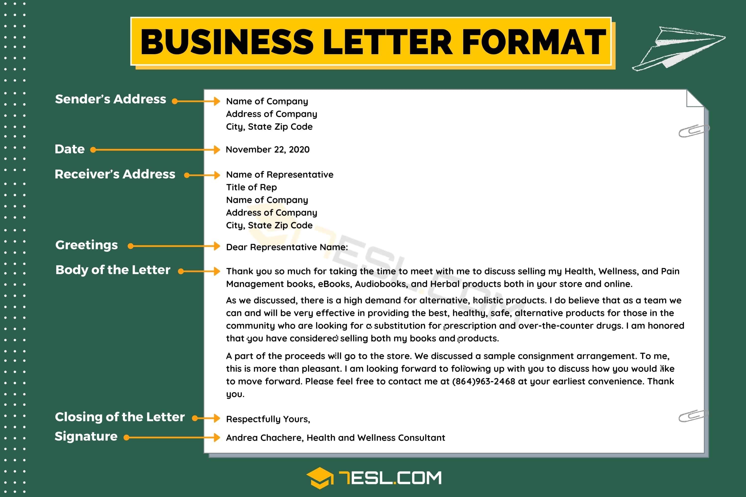
Standard Business Letter Format (3)

Slide 29
Features of business letters (1)
Letterhead
This will contain the basic information that the receiver will need in order to reply to the letter.
The organization’s name and status e.g. Limited identifies a limited liability company.
The address of the company from which the letter is being sent
Telephone, fax and telex numbers

Slide 30
Features of Business letters (2)
It will often give some indication of the organization’s activity.
There are other details that may be included depending on the organization.

Slide 31
Features of business letters (3)
Must organizations have a Logo? – a visual image of what the organization does, how it sees itself and wants to be seen.
It is designed to capture attention, create an impression and stick in the mind.
Reference
Each letter will have to be precisely identified, so that it can be filed, and retrieved by its reference code.

Slide 32
Features of Business Letters (4)
Reference
“Our Reference” or simply “Reference” signals the reference given to the current letter
“Your Reference” tells the recipient the reference number of his letter to you, which you are now acknowledging or referring to.
This will enable him to retrieve and refer to his copy of the letter, so that they will appreciate the details of your response.
References are commonly made up out of the originator’s initial/the typist’s initials (often lower case) plus a coded file reference.

Slide 33
Features of Business Letters (5)
Date: Business letters are dated for historical and other purposes. The date indicates the date the letter was written. It is written in different forms.
Use month, day, year format, e.g., March 3, 2013 or 3 March 2013
Sender's Address: It is a good idea to include sender's e-mail and URL, if available.
Don't include this information if it's already incorporated into the letterhead design. This will allow customers to find your small business more quickly.

Slide 34
Features of Business Letters (6)
Salutation
The salutation or opening greeting is conventionally paired with an appropriate complimentary close (the signing off), to end the letter in a similar tone
Dear Sir, Dear Madam, Dear Madam/Sir, Dear Sir, Madam all end with “Yours faithfully”.
Dear Dr. Mensah : ends with “Yours sincerely”.
A salutation may also address a position. Example: “Dear customer/applicant”

Slide 35
Features of Business Letters (7)
Subject Heading
This gives a one word, two-word, or a brief indication of the main subject of the letter.
It directs the reader’s thoughts to the matter at hand: customer complaints, appointment as sales manager, Termination of appointment, resignation, etc...

Slide 36
Features of Business Letters (9)
The Opening Paragraph
The opening paragraph refers to previous correspondence, acknowledgement of a telephone call, a request or explanation of the purpose of the letter.
The Middle
The middle paragraph will describe in sequence events or ideas relating to the opening paragraphs, keep the paragraphs short and simple.
You can have one sentence paragraph where appropriate

Slide 37
Features of Business Letters (10)
The Closing Paragraph
It should summarize all that you have previously said.
Be careful not to introduce any new ideas in the closing paragraph.
Complimentary close
This is the closing remark before the signature.
It serves as a polite transition from the end of the message to the signature.

Slide 38
Features of Business Letters (11)
Writer’s signature, name and position
There should be three spaces between the complimentary close and the signature line
Enclosure and copy references

Slide 39
Layout of Business Letters (1)
Fully-blocked layout
This is the easiest and the most widely used layout for business letters.
All text, including the date, the recipient’s address, subject heading, complimentary close and signature are aligned on the left margin.
The main body
Double spaces separate the paragraphs and the first line of each paragraph is not indented.

Slide 40
Layout of Business Letters (2)
Semi-Blocked
Some selected elements: - Heading, Complimentary close and signature, the writer’s name and position are aligned in a straight line-at the center of the writing line, between the left and right margins- .
At times, the date is written towards the right margin.
The Main Body
The first line of each paragraph is not indented.

Slide 41
Layout of Business Letters (3)
The Semi-Indented Style
This is similar to the semi-blocked, except that the first line of each paragraph is also indented.
Open or closed punctuation
Closed punctuation: - Using full stop for all elements.

Slide 42
Layout of Business Letters (4)
Open Punctuation
This involves omitting all punctuation from all other parts of the letter apart from the main body. It is commonly used with the fully – blocked layout.
Dates: No commas, no ^{st}, ^{th} or ^{rd}
No full stops in addresses and after abbreviations, no commas at the end of salutation and complimentary closes.

Slide 43
Tips to consider when writing Business Letters (1)
Writing an Effective Business Letter
Use a professional tone
Your printed business letter should be friendly but more professional.
Write clearly
State your point early in your letter.
To avoid any miscommunications, use straightforward, concise language.
Skip the industry jargon and instead choose lively, active words to hold your reader's attention.

Slide 44
Tips to consider when writing Business Letters (2)
Organize your information logically: Group related information into separate paragraphs.
In a long, information-packed letter, consider organizing information into sections with subheads
You may want to highlight key words in your message.

Slide 45
Tips to consider when writing Business Letters (3)
Be persuasive!
Establish a positive relationship with your reader right away.
If you have a connection to the reader - you've met before or have a mutual colleague, for example - mention it in your introductory paragraph.
Understand your reader well enough to anticipate how he or she will react when reading your letter.
Make sure to maintain a friendly tone.

Slide 46
Tips to consider when writing business letters (4)
Proofread your letter!
All your careful crafting and printing can't cover up spelling or punctuation errors, which leave a lasting negative impression.

Slide 47
SUMMARY
Types of letters (Informal, Semiformal and Formal)
Approaches to Writing Business letters (direct and indirect)
General purposes of writing Business Letters
Features of Business Letters

Slide 48
ACTIVITY
Explain the differences that exist in informal, semiformal and formal letter writing
Discuss the approaches to writing business letters.
Explain the purposes for writing business letters.
What are the features of business letters?

Slide 49
REFERENCES
Overton, R. (2002). Business Communication. Martin Management Services.
Taylor, S. (2005). Communication for Business: Practical approach. Pearson Longman.

Slide 50
Q & A

Slide 51


